Slide 1
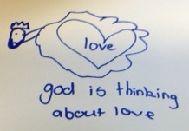
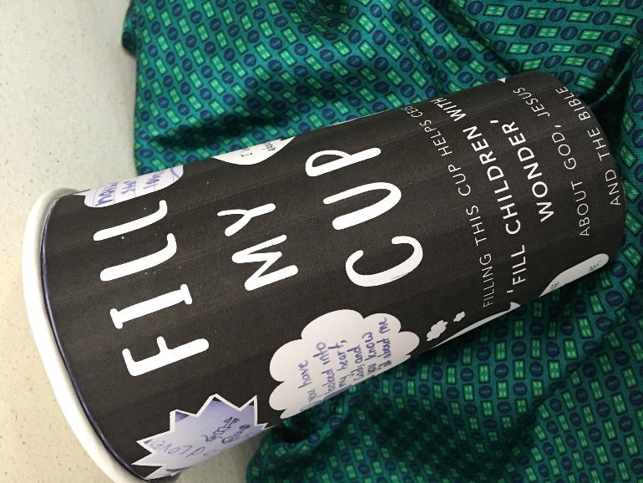
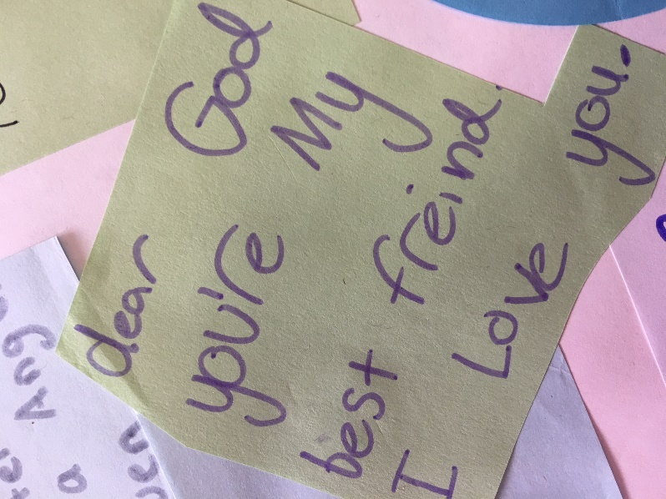
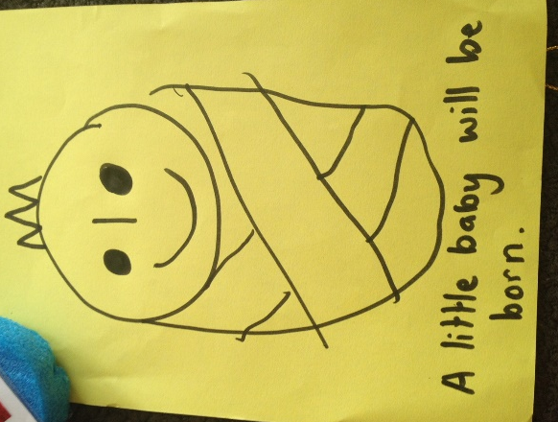
During morning tea please help us support Christian Education In Schools. Place your loose change or more in the special ‘Fill My Cup’ on display. Filling this cup will help CEIS continue to ‘fill children with wonder about God, Jesus and the Bible’.

